Slide 1


THE EVERCRAFTED COMPOSITION ENGINE PIPELINE
Emotion becomes engineered design.
A deterministic 10-engine system that transforms a single emotional memory and a stem inventory into a mathematically balanced, reproducible wreath blueprint.
10 Core Engines
0.78 Min Score
8 Repair Passes
7 Score Metrics

Slide 2

01
Memory Interpreter
— Input Layer
Ten engines. One deterministic output.
02
Emotion Mapper
— Signal Layer
03
Inventory Analyzer
— Inventory Layer
04
Formula Selector
— Selection Layer
05
Anchor Generator
— Geometry Layer
06
Zone Field Builder
— Zone Layer
The pipeline executes sequentially — each engine feeds the next. No randomness escapes the system; every design is reproducible from its seed.
07
Stem Allocator
— Allocation Layer
08
Placement Solver
— Placement Layer
09
Repair Engine
— Repair Layer
10
Blueprint & Render
— Output Layer

Slide 3

01 — INPUT LAYER
Every design begins with a feeling.
{ "emotion": "nostalgia", "energy": 0.4, "palette_bias": "warm", "symbolic_tags": [ "evergreen", "berries", "pine_cone" ] }
The Memory Interpreter is the emotional gateway. It parses free-form text — a memory, a mood, an occasion — into structured design intent that every downstream engine can consume.
"nostalgic cozy Christmas"
Energy Level 0.4
Palette Bias warm
Symbolic Tags 3
Parse Method NLP

Slide 4

02–03 — SIGNAL & INVENTORY LAYERS
Emotion becomes palette. Inventory becomes possibility.
Emotion Mapper
Inventory Analyzer
Converts emotional intent into concrete design signals. A "nostalgic warm" emotion produces a deep red, pine green, and gold palette with moderate density bias and 0.7 contrast.
Converts raw stem inventory into five role pools. Calculates average bloom diameter, stem length, and a flexibility score that determines how many formula options are viable.
{ "palette": ["deep_red", "pine_green", "gold"], "contrast": 0.7, "density_bias": "moderate" }
{ "focal": 7, "secondary": 12, "accent": 9, "filler": 15, "greenery": 33 }
Flexibility Score 0.73

Slide 5

04 — SELECTION LAYER
The strategic brain of the pipeline selects the optimal design structure.
Scoring Model Weights
Inventory Feasibility
30%
Emotional Match
20%
The Formula Selector scores every registered formula across six weighted dimensions. The formula with the highest composite score is selected. Confidence is recorded in the Blueprint DNA.
Silhouette
15%
Negative Space
15%
Complexity
10%
Genome Compatibility
10%
SELECTION RESULT
Selected Formula: "crescent"
Confidence Score: 0.84

Slide 6

05–06 — GEOMETRY & ZONE LAYERS
Polar coordinates define where the design lives — and where it breathes.
Anchor Generator
Zone Field Builder
Transforms formula anchor group definitions into actual polar coordinates using seeded randomness. Every anchor is reproducible from the same seed.
Divides the wreath ring into angular sectors. Focal zones receive density targets of 0.9. The silence arc — intentional negative space — receives a density target of 0.1.
PRIMARY CLUSTER
θ = 218.3°, r = 0.73
FOCAL ARC
210°–260°, density 0.9
SECONDARY CLUSTER
θ = 247.1°, r = 0.71
SILENCE ARC
280°–330°, density 0.1
SEED
92384723
The silence arc is what makes the focal cluster feel powerful. Without intentional negative space, there is no focal point.
KEY INSIGHT

Slide 7
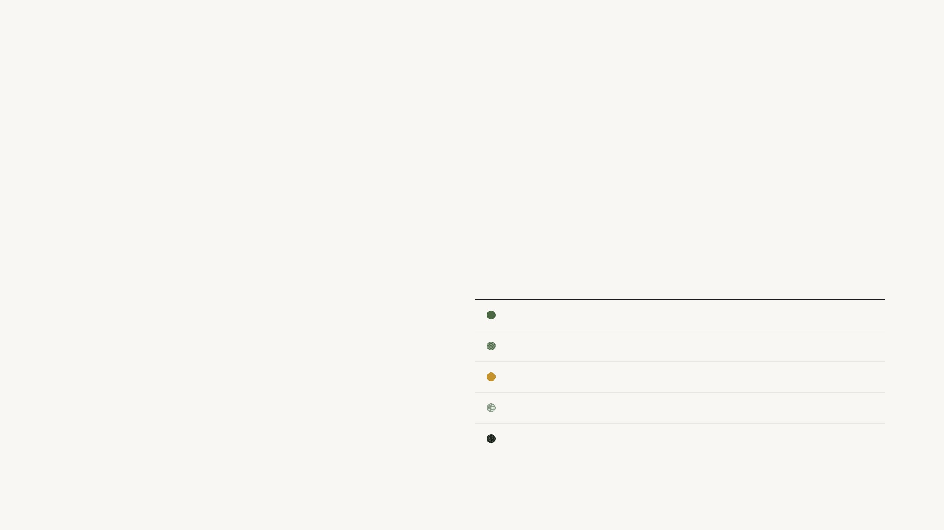
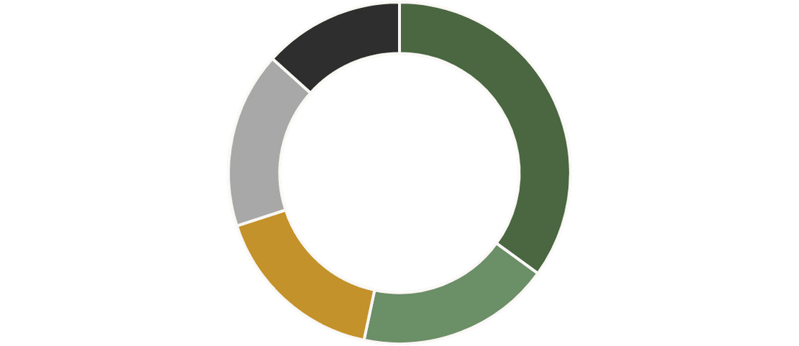
07 — ALLOCATION LAYER
The 60/30/10 rule governs every stem count decision.
The Stem Allocator distributes the total stem count across five roles using formula role bias ratios, adjusted for available inventory.
ROLE
COUNT
RATIO
Greenery
21
35%
Secondary
11
18%
The 60/30/10 proportion rule ensures structural integrity: 60% greenery skeleton, 30% secondary depth, 10% focal statement.
Focal
10
17%
Filler
10
17%
Accent
8
13%

Slide 8
08 — PLACEMENT LAYER
Depth Hierarchy (Bottom to Top)
Every stem receives a precise polar address, depth layer, and direction vector.
GESTURE
→
GREENERY
→
FILLER
→
ACCENT
→
SECONDARY
→
FOCAL
The Placement Solver assigns each stem its exact position in the design. Collision detection enforces minimum spacing as a multiple of bloom diameter — focal blooms require the most clearance to maintain visual dominance.
{ "stem_id": "023", "role": "secondary", "angle": 231.5, "radius": 0.72, "depth": 1, "vector": 245 }
Spacing Rules
Focal
1.3× diameter
Secondary
1.0× diameter
Filler
0.6× diameter

Slide 9

09 — REPAIR LAYER
The repair engine is what separates Evercrafted from a random generator.
The Repair Engine runs up to 8 iterative improvement passes until the design scores ≥ 0.78. If the threshold is not reached after 8 passes, anchors regenerate with a new seed offset and the pipeline restarts.
01
Density Normalization
02
Cluster Cohesion
Redistributes stems to match zone field density targets. Overcrowded zones shed stems; sparse zones absorb them.
Pulls scattered stems toward their nearest anchor point, strengthening visual groupings.
03
Silence Arc Enforcement
04
Focal Clarity
Clears the designated silence arc of non-greenery stems, creating intentional negative space.
Ensures focal blooms are unobstructed, correctly depth-layered, and meet minimum angular separation.
SCORE BEFORE
SCORE AFTER
PASSES RUN
THRESHOLD MET
CONVERGENCE RESULT
0.64
0.82
3
✓

Slide 10
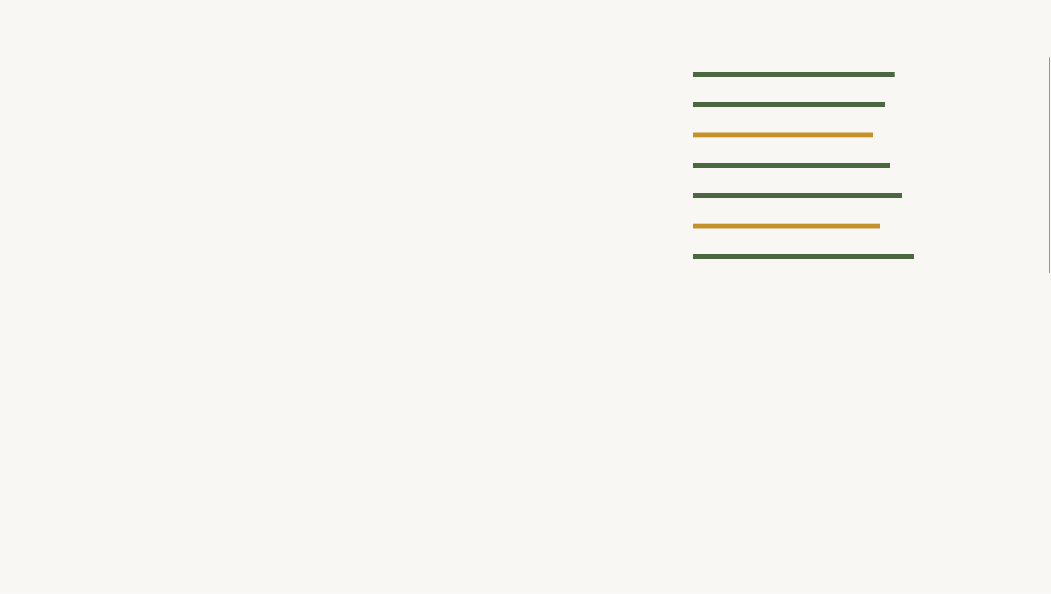
0.78 MIN
QUALITY GATE
Balance
0.83
A minimum overall score of 0.78 is required before any blueprint is approved.
Rhythm
0.79
Contrast
0.74
Density
0.81
Focal Clarity
0.86
Negative Space
0.77
Inventory Efficiency
0.91
Every generated design is evaluated across seven professional composition metrics. The scoring engine is the quality gate — no blueprint exits the pipeline below threshold.
Overall Score
0.82
✓
PIPELINE STATUS
Score ≥ 0.78 threshold met. Blueprint approved for export.

Slide 11

10 — OUTPUT LAYER
Blueprint JSON
.JSON
One solved design. Four deliverables.
Machine-readable design record, versionable and resellable.
Builder Guide
MARKDOWN / PDF
The Blueprint & Render Engine serializes the entire solved placement set into four distinct outputs — each serving a different user need.
Step-by-step placement instructions for the wreath maker.
Builder Guide Sequence
SVG Preview
.SVG
1
Place greenery skeleton
Visual canvas preview of the polar placement layout.
2
Place focal blooms
3
Place secondary blooms
Render Prompt
4
TEXT
Add accents
5
Fill with filler stems
Midjourney-ready photorealistic render prompt.

Slide 12
FLORAL INTELLIGENCE
Every stem behaves like a design organism with traits, roles, and substitution neighbors.
Rose Tamora
SKU: 96532NT
The Floral Genome Engine represents each stem as a structured design object. Genome records capture physical traits, emotional resonance, and a substitution chain — enabling the engine to find replacements when inventory is missing items.
DIMENSIONS
PHYSICAL TRAITS
3.8" Bloom · 18" Stem
Cluster · Velvet
ROLE CAPABILITIES
EMOTION TAGS
focal
secondary
romantic
luxury
Substitution Neighbors
Substitution Similarity Weights
English Garden Rose
→
Cabbage Rose
→
Ranunculus
30%
Bloom Size
25%
Gesture Type
20%
Texture
15%
Color Family
10%
Emotion Tags

Slide 13

COMPOSITION FORMULAS
FORMULA ID
NAME
CONFIDENCE
Six registered formulas define the structural vocabulary of Evercrafted wreaths.
crescent
Crescent Sweep
0.84
✓
focal_trio
Focal Trio
0.81
triangular
Triangular Balance
0.79
asymmetric
Asymmetric Weight
0.76
Each formula is a complete wreath structure definition — anchor groups, zone arcs, density curves, and role bias ratios. The Formula Selector scores all six and picks the optimal match for the current emotional intent and inventory.
full_ring
Full Ring
0.71
cascade
Cascade Drop
0.67
FORMULA SCHEMA KEY FIELDS
"anchor_groups" "zone_definitions" "density_curve" "role_bias"

Slide 14
{ "formula": "crescent", "seed": 92384723, "cluster_count": 2, "silence_arc": [280, 330], "stem_count": 58, "palette": [ "deep_red", "pine_green", "gold" ] }
DESIGN FINGERPRINT
Every design is deterministic, versioned, and reproducible from its seed.
Evercrafted is not a random generator. It is a deterministic floral design engine. Every generated wreath receives a unique Blueprint DNA fingerprint, ensuring that identical inputs always produce identical designs.
DETERMINISTIC SEED GENERATION
seed = hash(memory_input + inventory_signature + formula_id)
DNA Use Cases
■
Product identification and cataloging
■
Blueprint resale and licensing
■
Version control and design iteration

Slide 15

END-TO-END PIPELINE
From a single memory to a builder-ready blueprint in ten deterministic steps.
01
Memory Interpreter
06
Zone Field Builder
Parses emotional prompts into structured design intent and symbolic tags.
Divides the wreath into angular sectors with specific density targets and silence arcs.
02
Emotion Mapper
07
Stem Allocator
Converts emotional intent into concrete design signals like palette and contrast.
Distributes the total stem count across the five structural roles (60/30/10 rule).
03
Inventory Analyzer
08
Placement Solver
Categorizes available stems into role pools and calculates flexibility scores.
Assigns every stem a precise polar address, depth layer, and direction vector.
04
Formula Selector
09
Repair Engine
Scores and selects the optimal structural formula based on intent and inventory.
Runs iterative improvement passes until the design meets the 0.78 quality threshold.
05
Anchor Generator
10
Blueprint Generator
Transforms formula anchor groups into exact polar coordinates via seeded randomness.
Serializes the solved design into JSON, builder guides, SVG previews, and render prompts.

Slide 16

POST
/generate-blueprint
POST
/score-blueprint
Evaluates a blueprint against the seven professional composition metrics.
INTEGRATION LAYER
Initiates the pipeline, taking memory and inventory to produce a solved blueprint.
Five endpoints expose the pipeline as a callable API.
POST
/repair-blueprint
POST
/render-blueprint
Runs iterative improvement passes on a sub-threshold blueprint until convergence.
Generates SVG previews and photorealistic render prompts from a blueprint.
The Evercrafted engine is designed to be headless. Every core function — from generation to scoring and rendering — is exposed via a RESTful API for seamless integration into frontends, e-commerce platforms, or third-party systems.
POST
/export-blueprint
Serializes the final design into a downloadable builder guide and JSON record.

Slide 17
DEVELOPMENT ROADMAP
The MVP ships the engine. The vision ships the intelligence.
MVP Scope (The Engine)
Long-Term Systems (The Intelligence)
01
Inventory Analyzer & Formula Selector
→
AI Floral Image Analyzer
02
Anchor Generator & Placement Solver
→
Learning Memory Engine
03
Repair Engine & Scoring Engine
→
Formula Evolution
04
Blueprint Generator
→
Style Marketplace
05
Basic Render Preview

Slide 18

EVERCRAFTED
A floral CAD system. A design intelligence platform.
Translating human emotion and physical inventory into mathematically balanced, reproducible, and professionally scored floral compositions.
END OF DOCUMENT // ENGINE V1.0

